Slide 1
E-VARdrobe
By:
Sunil Kumar
170736
Group -15

Slide 2
INDEX
1. | Introduction
2. | Overview
3. | Goals & Challenges
4.. | Project Description
5. | Experiment & Result
6. | Future Work
7. | Conclusion

Slide 3
Introduction
Many of the presently existing Virtual Dressing Rooms area unit supported numerous approaches. Those area unit largely virtual avatars or fiducial markers, and that they area unit principally enhancing the expertise of online outlets. The main drawbacks area unit the inaccurate capturing method and the missing risk of a virtual mirror, that limits the presentation to a virtual avatar.
By utilizing depth cameras just like the Microsoft Kinect it becomes doable to trace the movements of a body, extract body measurements and moreover produce a virtual mirror with the corresponding video stream.The video image are often incorporated with a chunk of consumer goods frame by frame.

Slide 4
Overview
Trying on garments in stores nowadays is one amongst the foremost long tasks. sometimes long waiting periods have to be compelled to be taken under consideration, for instance once standing ahead of full fitting rooms.Furthermore, extra time is lost once taking garments on and off. Reducing now and serving to individuals to place on an outsized assortment of garment in reduced time was a relevant motivation for this thesis. victimisation trendy technology - hardware still as software package - the fitting expertise are often drastically improved.
Even in internet retailers individuals square measure terribly doubter shopping for garments as a result of a fitting of garments isn't doable. The techniques mentioned during this paper will enhance the looking expertise. It even offers customers a additional precise illustration than 2D pictures of the material they're willing to shop for and so this could additionally cut back the number of products the consumers come back.

Slide 5
Goals & Challenges
The aim is to form a Virtual room that realistically reflects the looks and therefore the behavior of garment. It ought to more adapt to specific bodies of various person reckoning on their body measurements. this can be one among the most challenges since the items of fabric ought to properly acceptable as several persons as potential freelance of their individual dimensions.
Technically speaking, the fitting area are supported the Microsoft Kinect, AN innovative technology that provides a brand new means of interaction between humans and therefore the pc. From the depth image of the Kinect the skeleton is extracted and therefore the position and orientation of the material ar custom-made in relation to the joint positions and body measurements. 3D models of the material are overlaid with the colour image from the RGB camera to get the perform of a virtual mirror. to attain a sensible simulation of the material, a physical simulation is performed on the garment. Providing a helpful association between the Microsoft Kinect and every one the opposite components of the appliance are another ambition.

Slide 6

Project Description
Our product will primarily be targeting three fronts:
Developing AR core technologies for identification and mapping of human body parts.
Designing systems for easy and accurate representation of human body parts and objects to be tried on it
Developing a developer friendly system of APIs for easy use by businesses
The general process of E- Vardrobe is explained in next slide

Slide 7
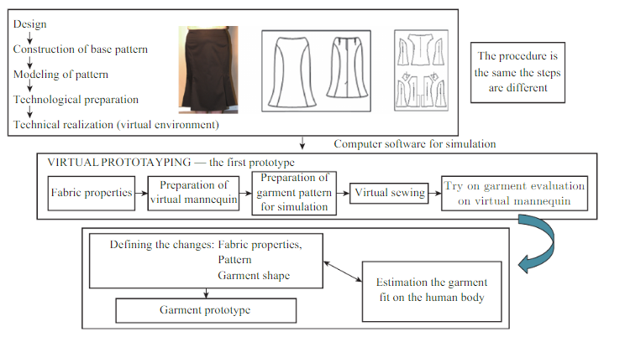

Slide 8
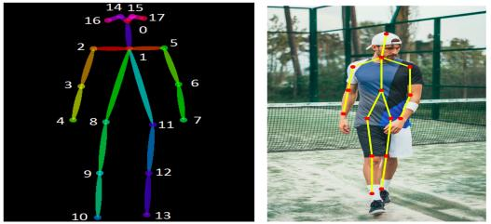
The following procedure was followed
Collecting Data from the customers
This includes 2d images which are taken at multiple angles.
Identifying anatomical key points on the body
Using the collected data to find anatomical key points which will be used to superimpose the apparel on the target body using RGB camera.

Slide 9
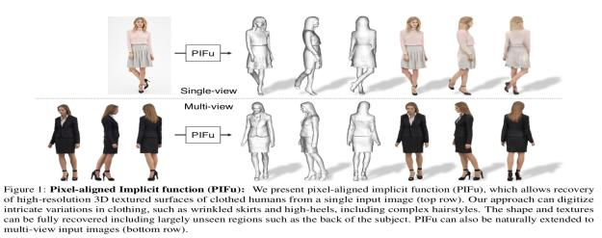
3. Fitting the nodes on the cloth with body parts
Mapping the anatomical keypoints with the corresponding points of the apparel.
Resulting in the superimposition of the apparel on the target body.
Constructing the 2d image.
4. 3d reconstruction of the body
Using the 2d image constructed in step 2 to generate a 3d reconstruction of the target body wearing the target apparel.

Slide 10
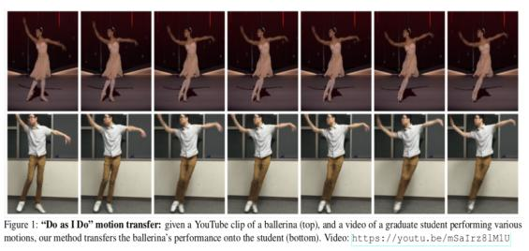
5. Showing movements
The 2d image constructed in step 3 will be used as the target image and motions will be simulated using the methods described in the paper below.

Slide 11

Experiment and Result
Developing AR core technologies for identification and mapping of human body parts.
We trained and tune our Human Embedding Model on the COCO keypoint detection dataset and beat multiple benchmarks on MPII Multi-Person benchmark, both in performance and efficiency. Additionally, we tried our embeddings on human_prot dataset and beat the previous State of the Art by 20% in terms of net MAP score. We are delighted to inform that we have devised a SOTA industrial-grade AR engine for human body representation. We got an accuracy of 90% on HumanREP dataset and about 95% of our 6,000 random first testers gave us an approval rating of 9 stars or above in the Amazon BLACKBOX tester.

Slide 12
Designing systems for easy and accurate representation of apparels
We were able to get quite a decent results on the models we hired in studio like conditions. However, real life testing has highlighted certain challenges that need to be tackled before a full fledged launch
Developing a developer friendly system of APIs for easy use by businesses
Our code base is made keeping extensibility in mind, We strongly believe that extensions would not be a big challenge

Slide 13
Future Work
The Virtual Dressing Room can be enhanced in some points. Primarily taking a look at the RGB camera of the Kinect, an improvement concerning its resolution can be meaningful. The current resolution is quite low which results in a bad quality of the recorded scene. Of course, this would need a careful calibration, also implicating the position of the camera regarding depth sensor.
Moreover adapting the illumination of the garment to the lighting conditions of the captured video stream of the real world could be an useful addition in regard to realism as well. Another improvement could be the implementation of a complete scanning procedure of the body that is executed prior to the tracking process. This would result in a more precise adaption of the cloth and can further include the depth/side measurements of a body.

Slide 14
Conclusion
This project aims to greatly enhance and simplify customer experience in the online retail section. It has the potential to revolutionise the online apparel shopping experience and boost the businesses of E-Commerce giants and startups. We consider E-Commerce companies as the major source of funding considering the extensive utility of our product for them. Other interested parties may include fashion retailers and any investor who is looking for an association with a potent B2B venture!
The end product would be a setup that will help our customers to take a one-time body scan of their potential customers and the software which they can use on their platform to provide their customers with the online virtual shopping experience and also recommend the best choice. This experience includes:
2d images of customers wearing the corresponding apparel
3d reconstruction of the same
Videos showing movements of the customer wearing the apparel

